Slide 1


Tripal elasticsearch module
Ming Chen @ Staton Lab

Slide 2

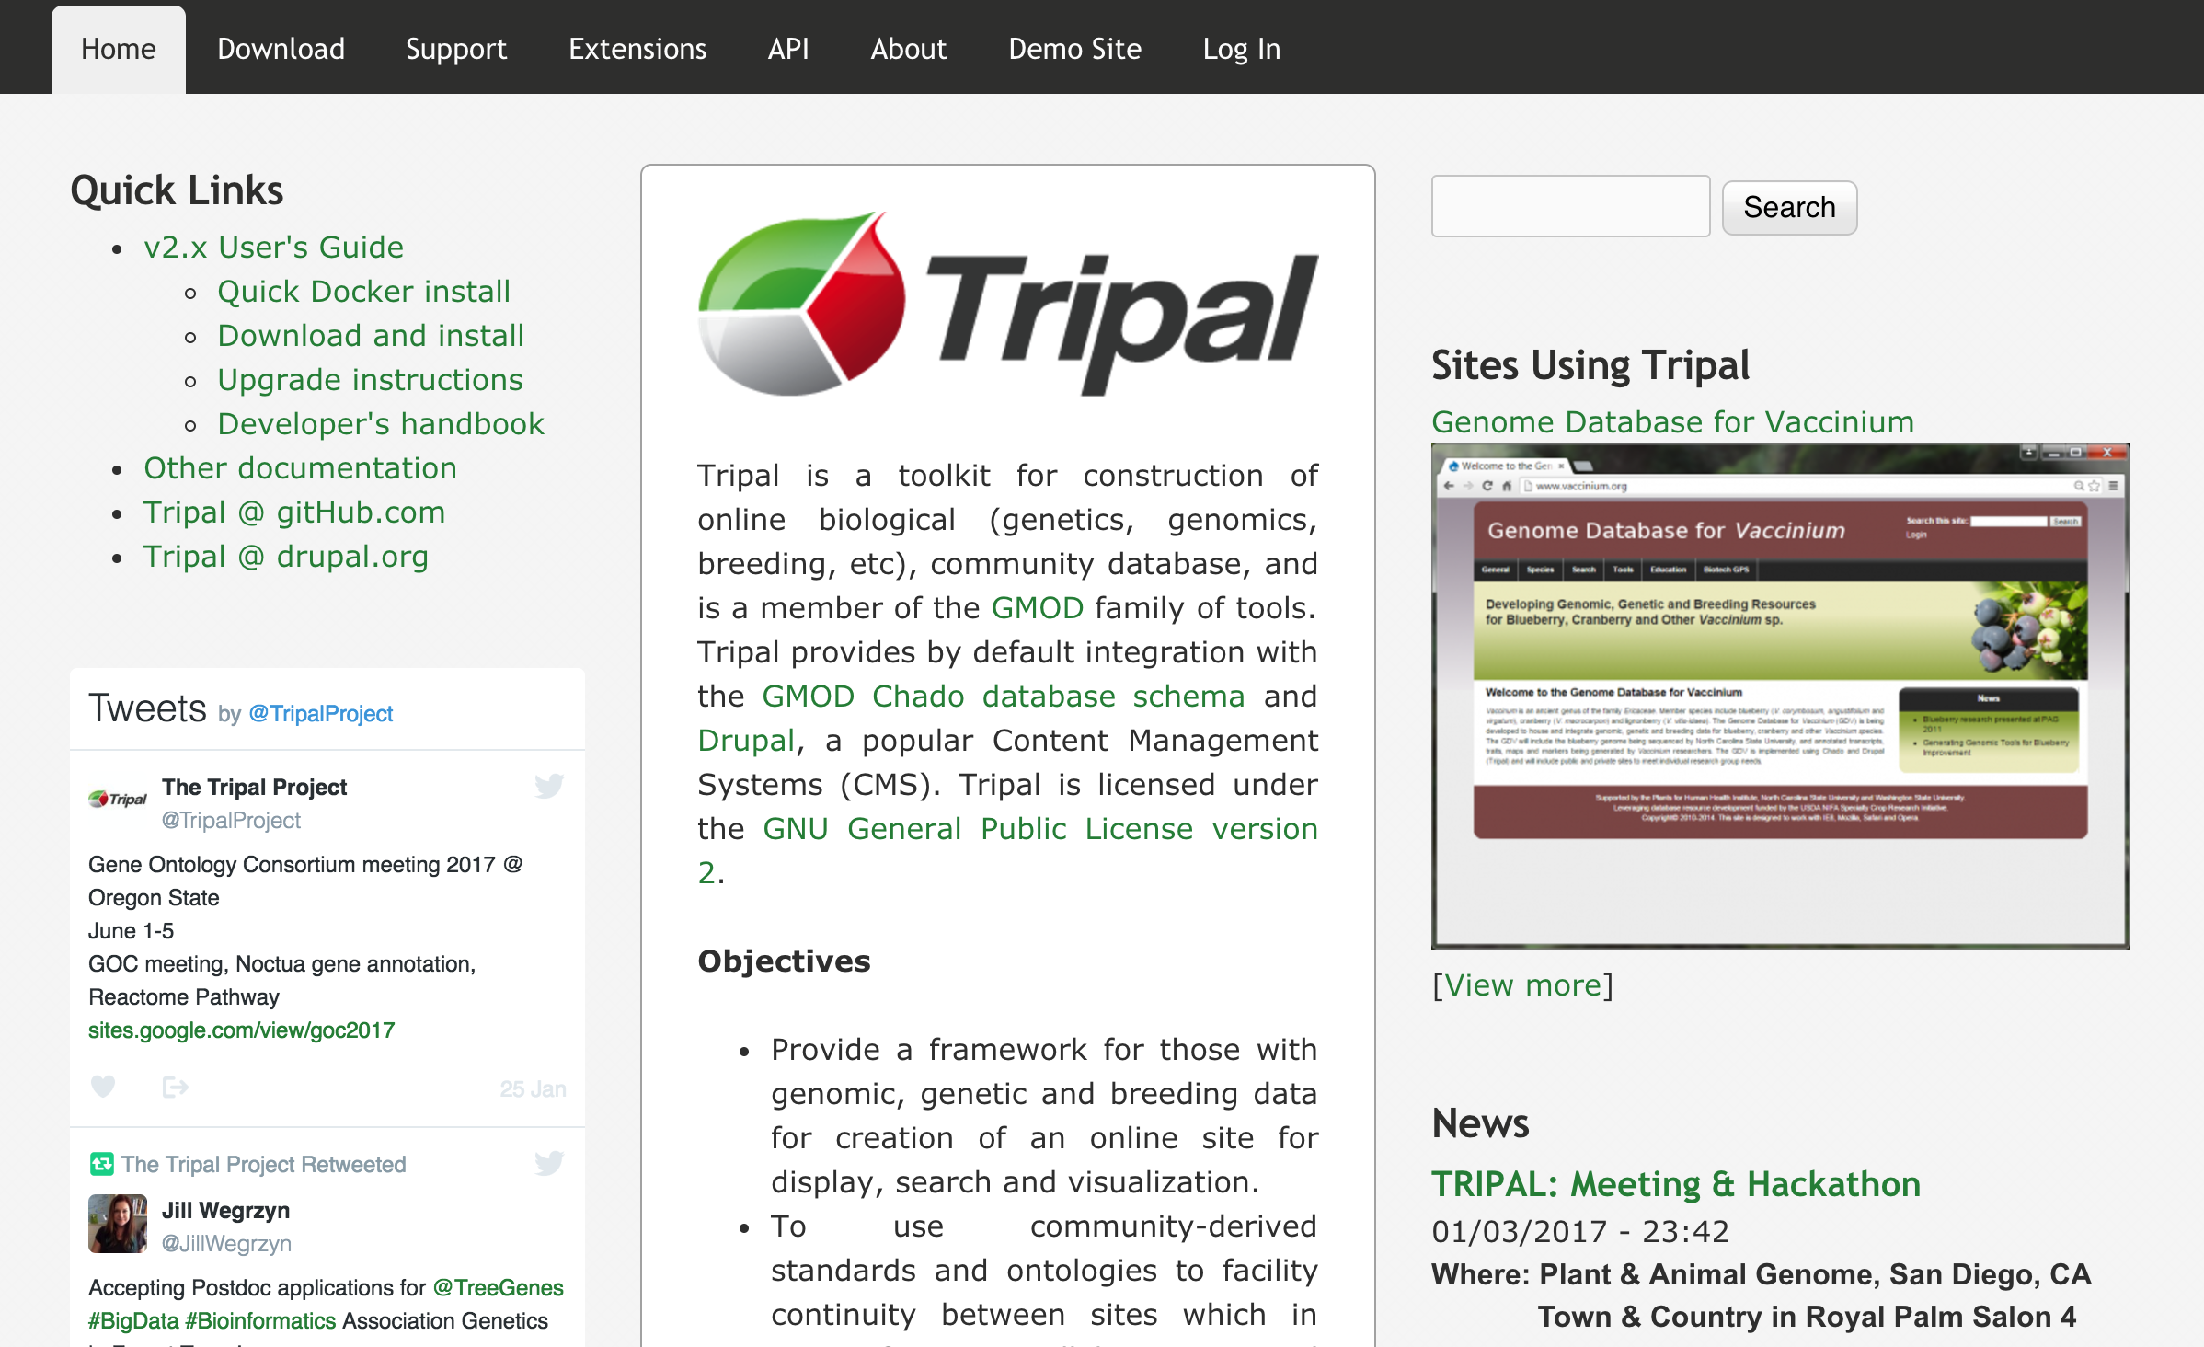
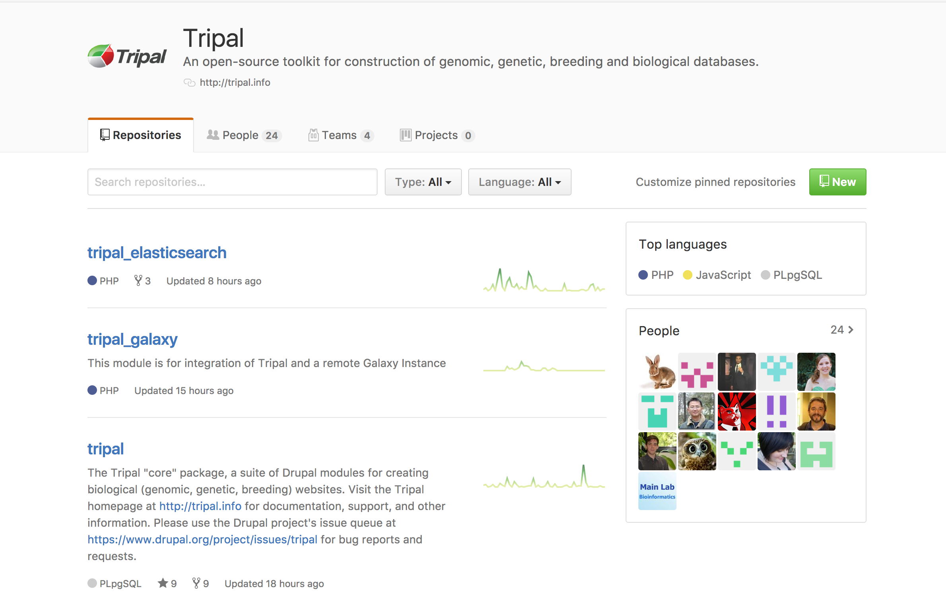
A suite of modules for construction of biological web databases
http://tripal.info
https://github.com/tripal

Slide 3


Slide 4




Notes:
Drupal is free, open source software that can be used to easily create and manage many types of websites, even for those lacking technical skills.

Slide 5
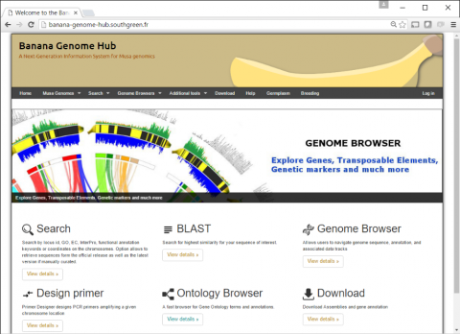
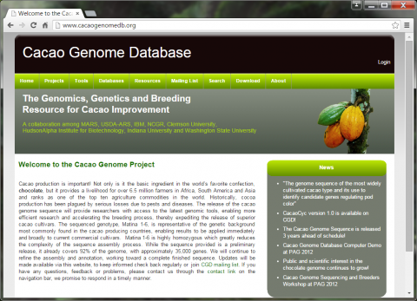
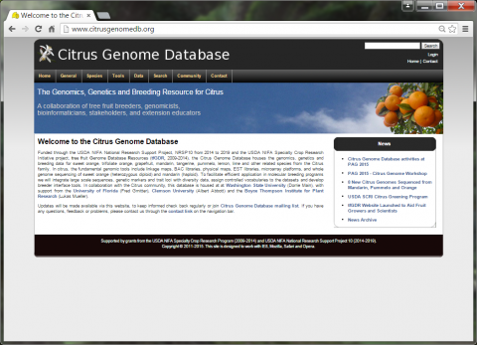
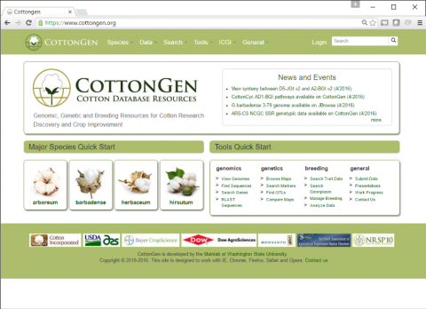
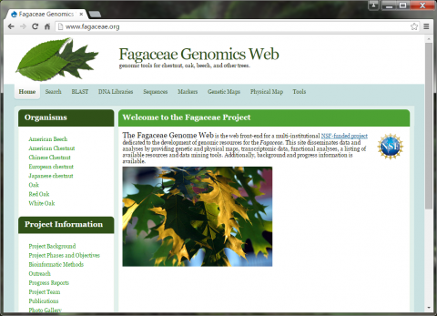
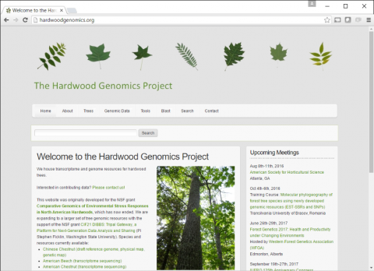

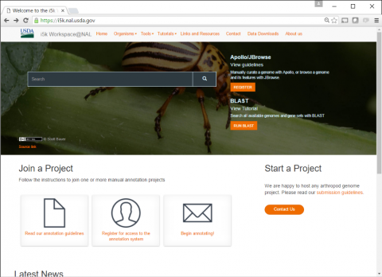
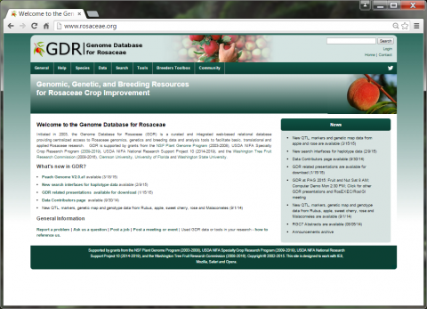
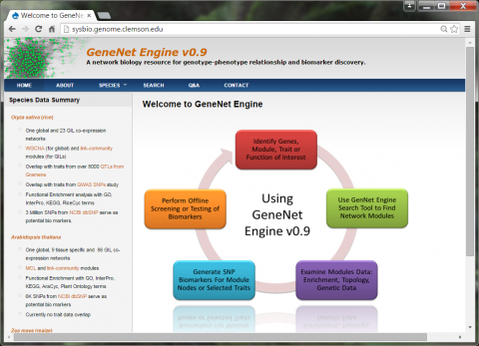
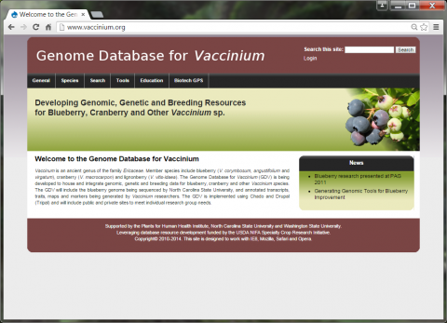

Slide 6
Problems that tripal-based databases
Lacking site wide indexing/search
Can’t index all data from the chado database

Slide 7



We need a search engine that provides efficient indexing and search, like

Slide 8
Why
Indexed data becomes searchable immediately, even the indexing process is still ongoing.
Hundreds of search APIs that provides fast, incisive search against large volumes of data
Broadly distributable and highly scalable:
An elasticsearch cluster can consist of nodes that are hosted at different servers
You can add or remove nodes to change the size of elasticsearch cluster

Slide 9
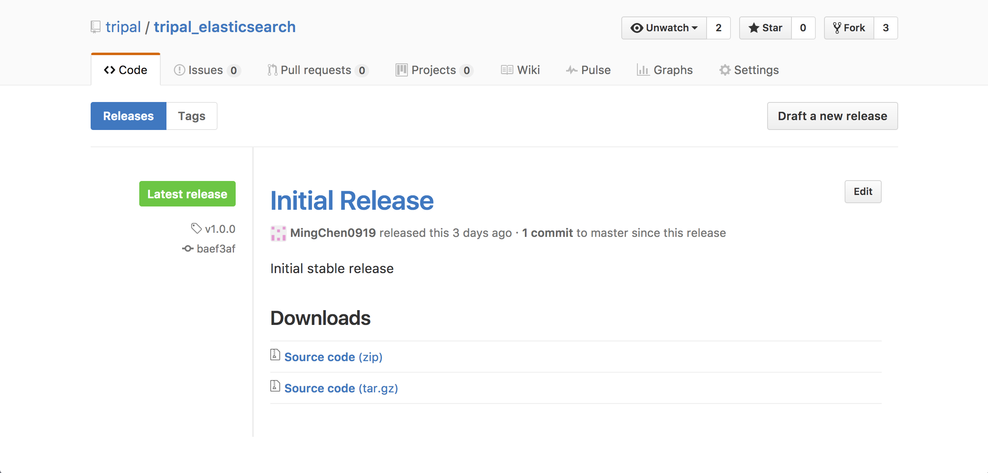
Tripal elasticsearch module on github

Slide 10
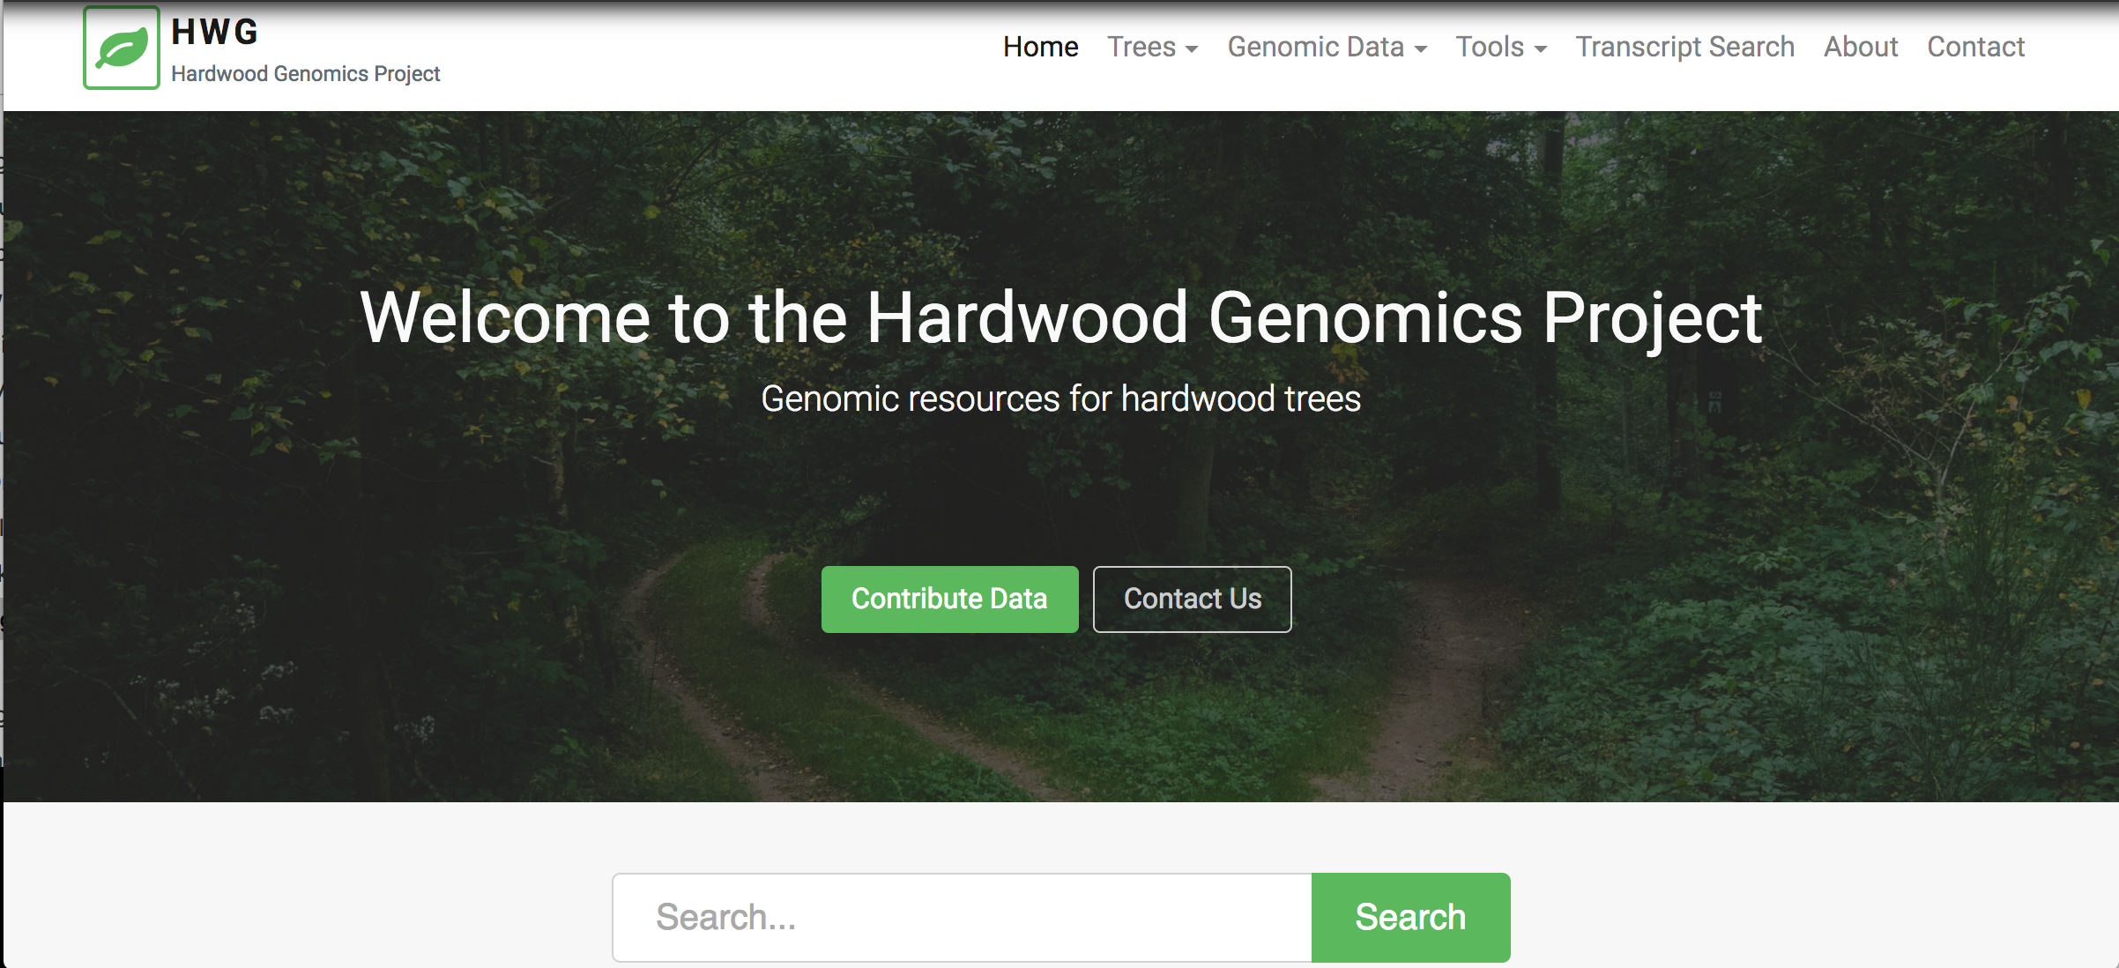
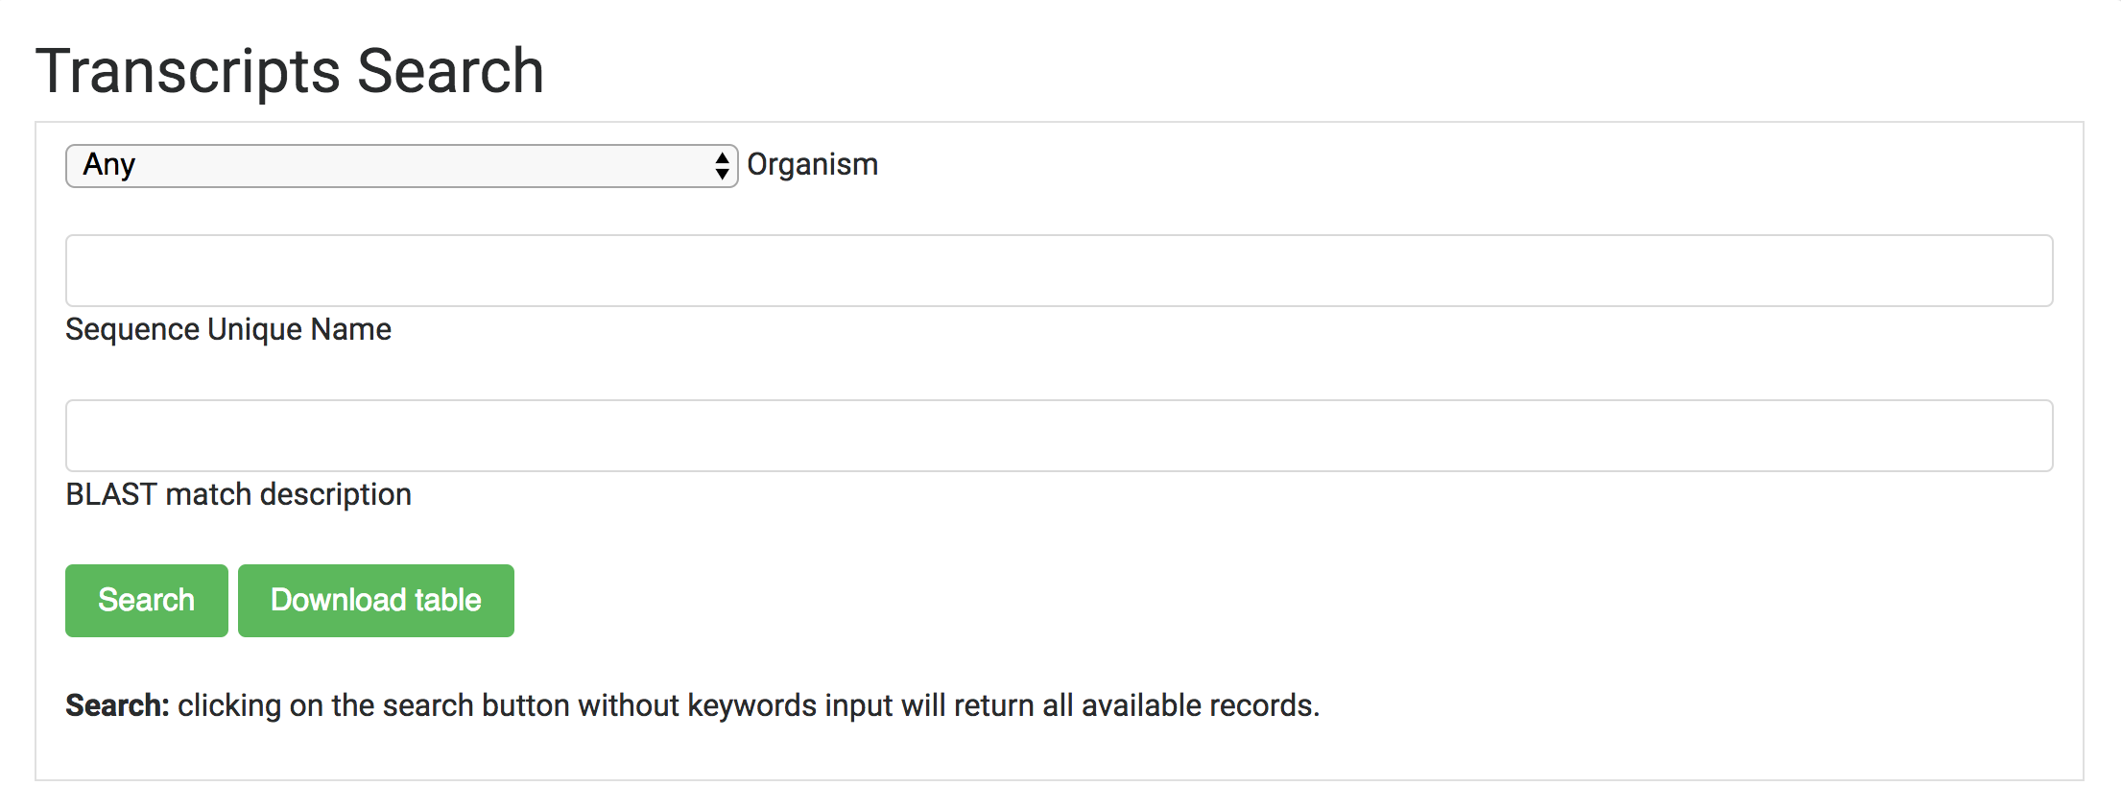
Implementation on the Hardwood Genomics Database (HGD)
Can index every single page
Any page content change will be automatically detected and re-indexed
Can build interface form for any tables from the database
Allows connection to both local and remote cluster
Wildcard search (*): genom* sequence -> genome, genomic, genomics ...
Fuzzy search (~): sequeeence~ -> sequence
Regular expression search (/…/): /transcriptom[a-z]+/ -> transcriptome ….
Boolean operators (+/-): +"green ash" +transcriptome –genome
AND, OR, NOT, phrase search (“”) and parenthesis to group searches
"heat stress" AND ("Castanea mollissima" OR "green ash") NOT "heat shock"

Slide 11




University of Tennessee
Meg Staton
Nathan Henry
Abdullah Almsaeed
Michelle Zhou
The Tripal Community
Stephen Ficklin (Washington State Univesity)
Lacey Anne Sanderson (University of Saskatchwan)
Anthony Bretaudeau (INRIA/Irisa)
Sudhansu Dash (NCGR)

